Slide 1
Thriller Opening Sequence
Ella
Kim
Aimee

Slide 2
Narrative
To start off our opening sequence for our Thriller movie we will start it with a wide shot of an abandoned house, with quiet music and no other sound (might adjust) the camera will smoothly and slowly move towards the house the door will ‘automatically’ open which will add a bit of mystery to what is in the house. The camera will tour around the house taking notice of all the broken, rotten and old parts of the house also showing that its abandoned and it is very isolated. The camera makes its way to the top of a stair case, the camera will then tilt and there will be a glow at the bottom, the music gradually goes away and gets taken over by shouting and laughter from some teenagers in the room at the bottom of the stairs. This will give the audience a sign of a relief as it isn’t anything scary at this point. The camera gradually makes it way closer to the teens, close enough for the audience to realise they are playing a game of spin the bottle. As one of the teens go to spin the bottle the camera quickly flies ‘inside the bottle’ and acts as the bottle (also this is supposed to indicate a spirit or a strange presence) as the bottle/camera spins you see all of the faces of the teens and once it stops on one person the camera rushes towards the face and is made out as if it has entered the teens body. The camera then quick cuts around the circle of all the teenagers faces and they are confused and worried then the camera slowly rotates around to the chosen teen to see her/him with a nose bleed, white eyes and bruises all over her/his face and chest. The film title will then gradually pop up on screen leading into the rest of the film.

Slide 3
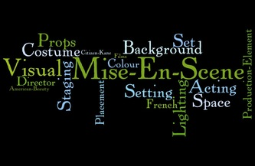
Sub-Genre & Conventions
Our Sub-Genre
The sub-genre for our film will be as we want it to be quite scary and to make the audience feel nervous and scared. Our opening sequence does reflect this well as the mise-en-scene will set the mood well as it is filmed in an abandoned house. Also the strange things that we have planned to happen in the opening sequence also indicates the film to be a horror.
Codes & Conventions
Mise-en-scene
Horror movies should be set in isolated places where there is no help for characters.
Use of pathetic fallacy like thunder and rain to enhance the feel of isolation.
Props
Horror movies include weapons and other items made to protect someone.
Large paintings are also a big prop for a sinister feel.
Colours
Horror movies normally use reds and blacks because they annotate danger.
Lighting
Horror movies use lighting to help indicate something bad happening -> shadows and lights flickering make the audience feel scared and nervous.
Costume
In horror movies the costumes vary because they have stereotypical characters which are dressed differently, for example the blonde girl will dress girly, pinks and mini skirts and the athlete will be wearing a tight top or vest. This helps create the characters.

Slide 4
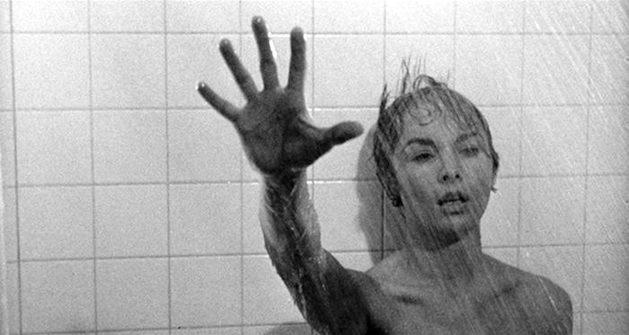
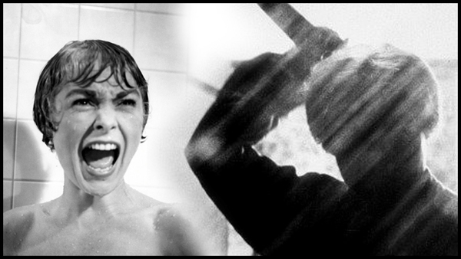
Codes & Conventions - Sound
Sound
Audio is key when editing, using Foley (foley is the reproduction of everyday sound effects that are added to film) sound will help build suspense.
Exaggerated diegetic sound will allow tension to be created.
Fast and loud non-diegetic sound can add to making the audience jump or feel scared. Eg the music in the shower scene in ‘Psycho’.
From this scene you can see the effect music has on a scene of a film, here is a video of the music playing showing the intensity it makes and then again without the music which shows how different it can make a scene feel.
https://www.youtube.com/watch?v=81qweiWqyTU

Slide 5
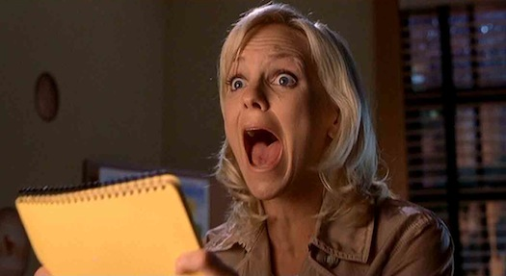
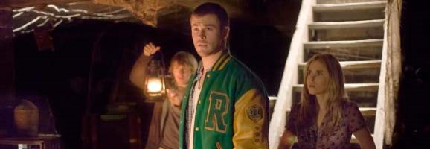
Codes & Conventions - Characters
There are always stereotypical characters in horror movies. This also helps the audience be able to identify what sort of genre the film is from. For example the characters are;
The Blonde – usually the one that’s dies first and that the boys all love, also usually used as a sexual object and led to be dumb.
The Athlete – usually the one everyone looks to for guidance and to be a hero.
The Couple- normally always a couple that are very lovey dovey and cant keep their hands off each other.
The Dead Meat – always someone that you can tell from the start who will die, usually in a dumb way.

Slide 6
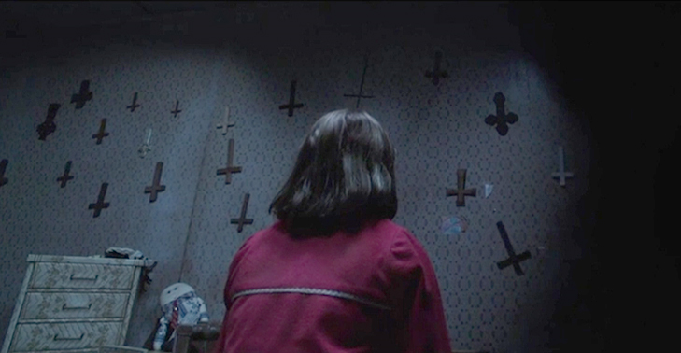
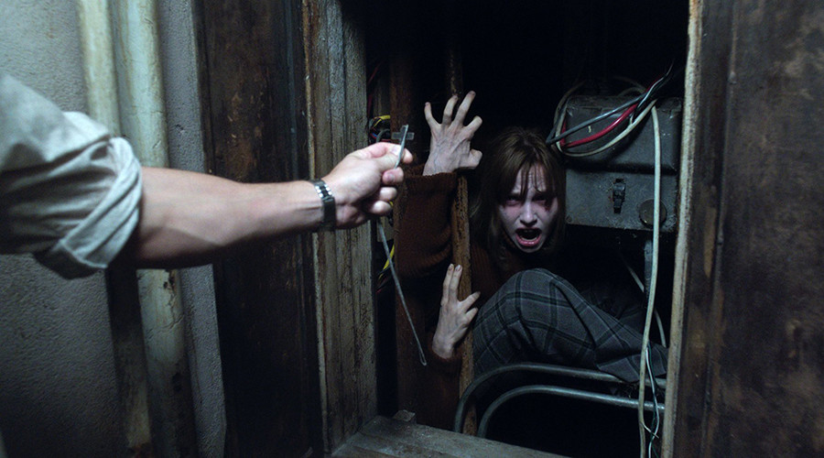
Codes & Conventions - Props
Props
Many props are used in horror movies which indicate horror for example;
Bibles
Crucifix
Paintings
Candles
Weapons
The props such as a crucifix are used as a sign of religion and symbolizing the devil. Also this is used as a sign of defence from god because people believe it protects them from paranormal beings.

Slide 7
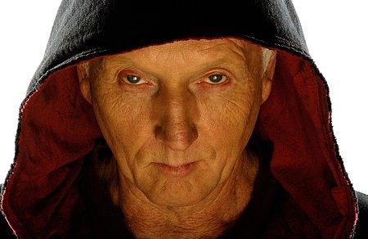
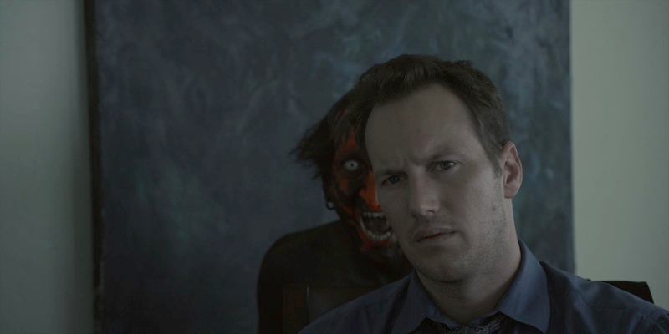
Character Types
The characters that are going to be included in our opening sequence will definitely be a ‘blonde’ which can play the part of the teen that gets possessed whilst playing the game. We will also include an ‘Athlete’ and a ‘couple’ although they wont have dialogue it will be good to include them into the opening sequence because it can help indicate the kind of film it will be. Also it will help the audience predict each characters fate and if they will benefit themselves and others in the film.
The characters in the film will be protagonists as they aren't going to be evil or against anything as they will be shown as more of the victims to a ‘paranormal’ presence.

Slide 8
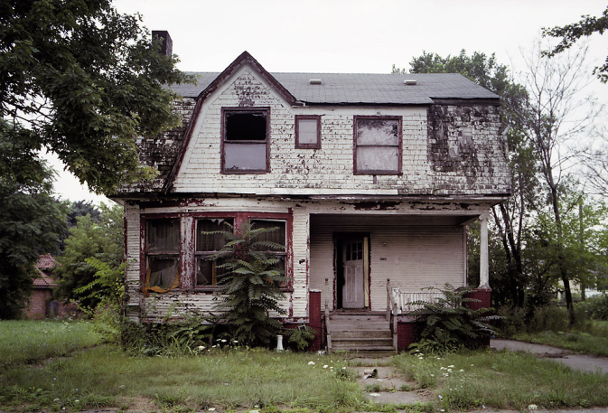
Suggested Locations
We want to film our opening sequence in an abandoned/empty house so that it will fit the feel we want the film to have also because our films sub-genre is horror and an eerie house is a good factor to have.
The only problem we have is that we are finding it difficult to find abandoned houses in the local area, and the ones that we have found have been bordered up.
The location we want isn't that reliable as it is unpredictable what can happen to it, it may be unsafe to enter or illegal also there could be people or animals living in them which could be dangerous.
The lighting will be difficult to control in a place like an abandoned house because it wont have any electric to plug in lights to help make goof lighting, also we want to film in the evening when its quite dark which will also be difficult to control with not lights because the audience might not be able to see anything.
Also the sound inside the house should be fine as long as it isn't near a main road where there will be lots of cars making noise. Especially because we want the film to be spookily quiet at the start.

Slide 9
British Board of Film Classification
Our target audience for our thriller-horror opening sequence will be for teenagers 12 and over, as the film isn't going to be that scary and according to the BBFC is appropriate for 12 year olds.
The opening sequence doesn’t include any nudity, violence, sex, imitable behaviour, drugs or discrimination. Although most of these are moderately accepted, the opening sequence will only show some bruises, blood and obviously a horror threat.
Although the BBFC say that for a 12 rated film there shouldn’t be horror threats completely throughout a film but it is appropriate for a 15 rated film. This is where we are confused whether it should be a 12 or 15.

Slide 10
Our Roles
Director – Ella
A film director is a person who directs the making of a film. Generally, a film director controls a film's artistic and dramatic aspects, and visualizes the script while guiding the technical crew and actors in the fulfilment of that vision.
Camera & Lighting (Cinematographer) – Aimee
A cinematographer or director of photography (sometimes shortened to DP or DOP) is the chief over the camera crews working on a film, television production or other live action piece and is responsible for making artistic and technical decisions related to the image.
Production Sound – Kim
Sound design is the process of specifying, acquiring, manipulating or generating audio elements. It is employed in a variety of disciplines including filmmaking, television production, theatre, sound recording and reproduction, live performance, sound art, post-production, radio and video game development.
Costume – Ella
A costume designer is a person who designs costumes for a film, stage production or television.
Hair & Makeup – Kim
A make-up artist or makeup artist is an artist whose medium is the human body, applying makeup and prosthetics for theatrical, television, filmmaking, fashion, magazines and other similar productions including all aspects of the modelling industry.
Special Effects – Aimee
Special effects (often abbreviated as SFX, SPFX, or simply FX) are illusions or visual tricks used in the film, television, theatre, video game, and simulator industries to simulate the imagined events in a story or virtual world.
Post-Production – Ella, Kim, Aimee
work done on a film or recording after filming or recording has taken place.
"post-production editing"

